Slide 1
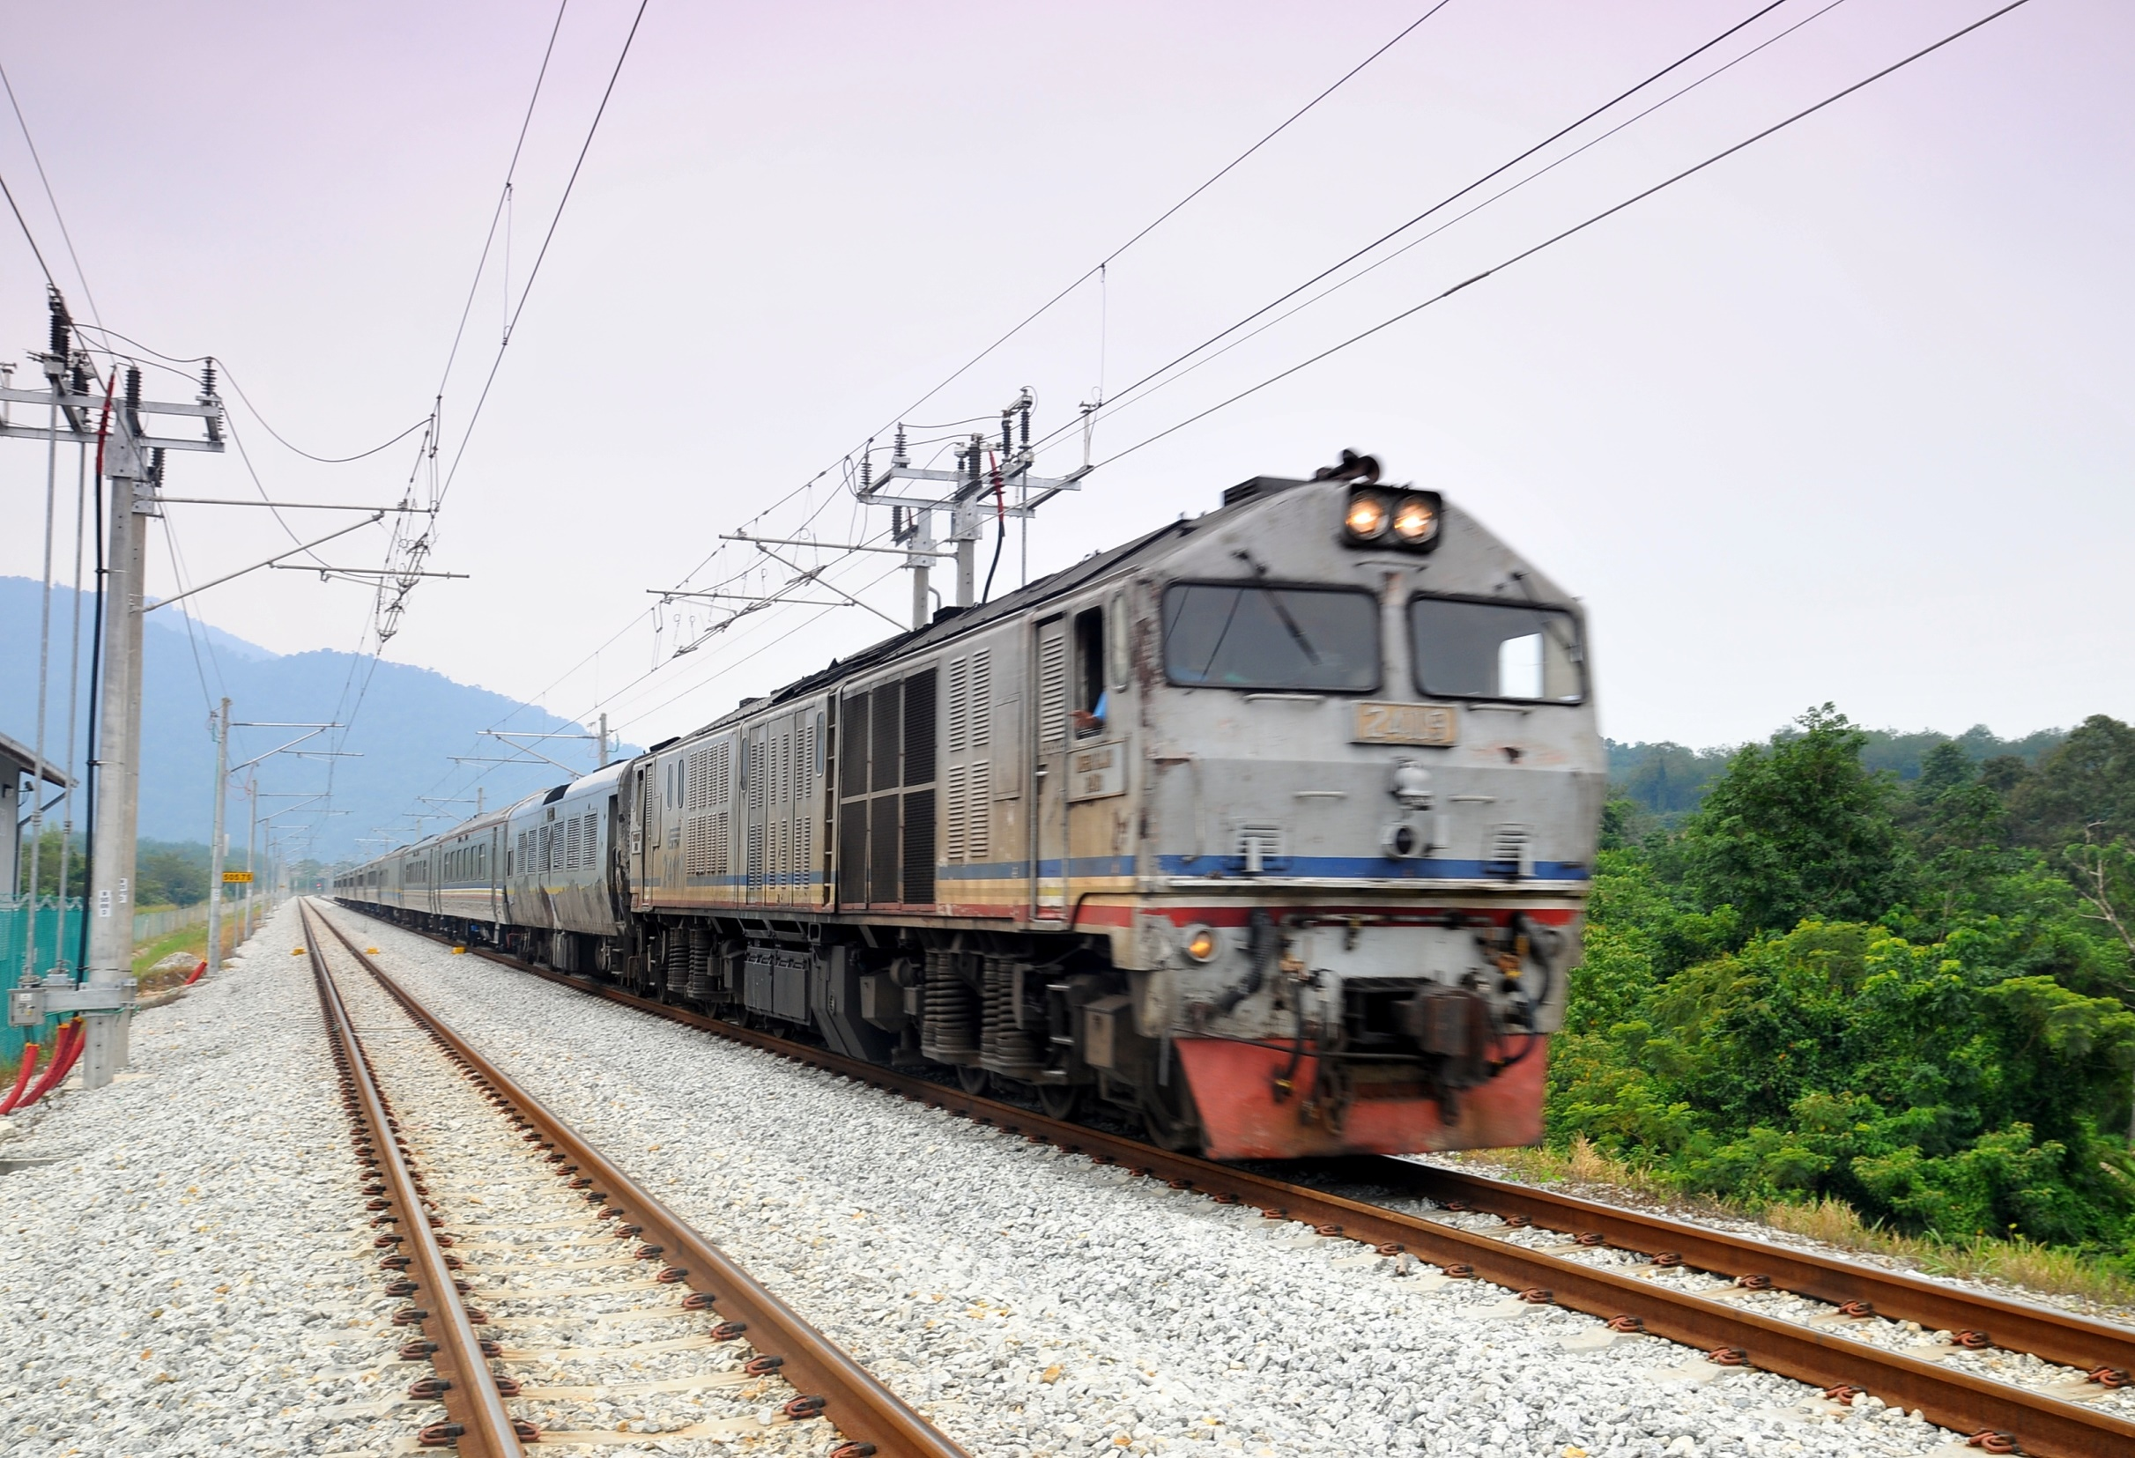
Semi High Speed Trains on Indian Railways Network
Track, and Vehicle Side Demands
-HITESH KHANNA, ANISH KUMAR
IRCON INTERNATIONAL LTD.

Slide 2
PRESENTATION SCHEME
Part A
Design Philosophy - Semi High Speed Rail (S-HSR)
Part B
Design Challenges & Track Parameters for Mixed Traffic
Part C
System & Coach Side Requirements for S-HSR
Part D
SGEDT/Malaysia Project; IRCON experience in Design & Maintenance of Semi High Speed Track with mixed Traffic

Slide 3
PART A: Conventional Vs. High Speed Track
Load Transfer (Layer by layer), on principle of Stress Reduction
Quasi-static forces on Curves
Load generated at Rail –Wheel
Dynamic Load
Low frequency steady state
High frequency impact load
Notes:
The design philosophy is different for conventional track & high speed track.
For a conventional track, the design loads are quasi-static forces, which gets transferred to the formation on a layer by layer stress reduction mechanism.
But for a high speed track, the design loads are the dynamic cyclic loads which comprises of both, a high frequency impact load and low frequency steady state loads. Apart from it, the irregularities at rail wheel level also contributes significantly towards augmenting additional dynamic response..

Slide 4
WAVE LENGTH OF IRREGULARITIES
0 – 0.3 m
0.3 – 3 m
3 – 10 m
10 – 120 m
λ
Rail –Wheel Interaction
Rail – Weld &
Rolling Defects
Rail Burnt / Squats etc.
Long Misalignment Formation /
Ballast Settlement
Cause
f
f = 100 -1000 Hz | f = 20-120 Hz | f = 5-20 Hz | f = 0.5 – 5 Hz
Rail Wheel Contact | Wheels | Bogie | Sprung Mass
Safety |  |  | Passenger Comfort
Affect
Notes:
The surface irregularities at rail level, vary in length. Surface irregularities upto 10 m are termed as short wave defects and longer irregularities are called long wave defects. The shorter irregularities produces high frequency dynamic loads, it augments derailment forces and hence compensated by primary suspension system of vehicle bogie itself.
The long wave defects which are normally generated due to long misalignment, track settlements etc…and it affect the passenger comfort and hence compensated by secondary suspension system of the bogie.

Slide 5
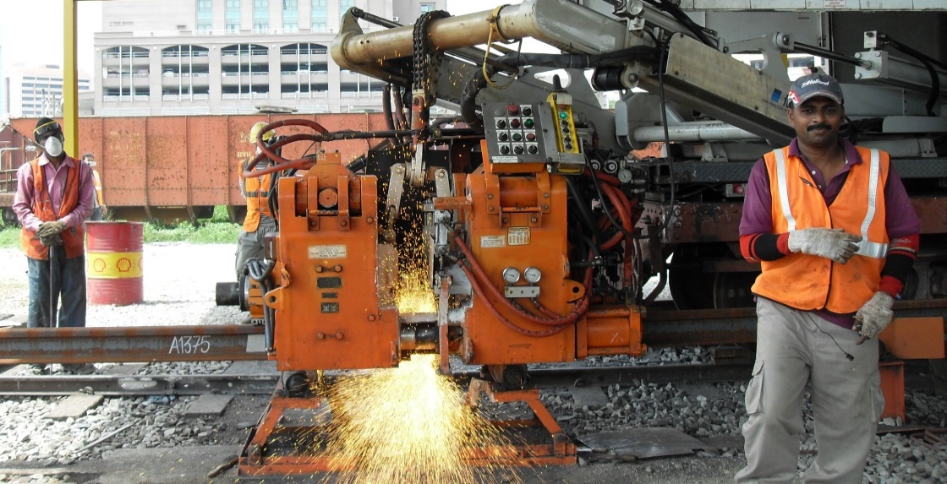
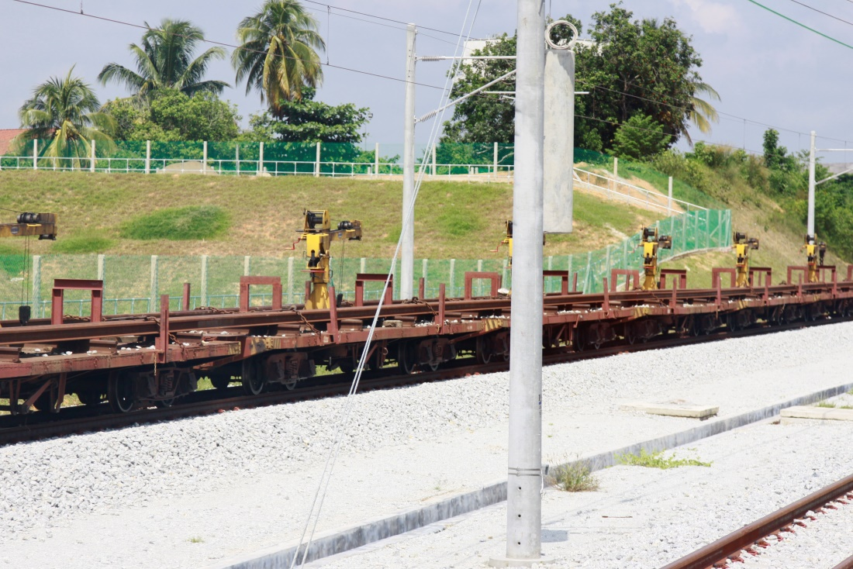
Short Wave Defects
1) Short wave defects are:
surface irregularities, corrugations, poor weld geometry etc.
2) Related with Rail - Wheel interaction.
3) Short wavelength defects are managed at a bogie level.
4) Solution to Short wave defects : High Speed Rail Grinding Wheel Scanner
Notes:
Short wave defects are eliminated by rail grinding….now high speed rail grinding m/c are available which can grind rails to the tune of 0.05 mm, at 70 kmph working speed. Rail grinding also eliminates early crack propagation. Rail grinding at regular interval is a prudent track maintenance practice worldwide for high speed track.
Wheel scanners are also used, for checking and preventing surface irregularities at wheel, which also generates high frequency impact loads.

Slide 6
LONG WAVE DEFECTS
Caused due to ballast/formation settlements
Related with Vehicle - Track interaction.
Any forcing frequency generated at rail-wheel interaction, within the range of 0.5-10 Hz, is considered critical for the rolling stocks.
4) Measurement of long wave defects by,
Inertial measuring system (measuring spatial curve); EM 250
Notes:
Long wave defects are generates resonant dynamic response matching with coach natural frequencies..and hence causes passenger discomfort. Our normal track tamping machines with 13 m cord measuring system can not measure long wave defects. For measuring and eliminating, long wave defects, track tamping m/c needs to be equipped with spatial curve measuring system. For speed up to 160 kmph, all surface irregularities ranging upto 25 m, needs to be eliminated. Therefore, advance track tamping m/cs which can measure long wave defects are essential for maintaining even semi high speed tracks.

Slide 7
PART B: Design Challenges for Mixed Traffic
Notes:
This venn diagram depicts the important track design parameters which critically affects the track design for mixed operation, from both speed and weight criteria. Cant, rate of change of cant and radius of vertical curve are more sensitive design parameters from both speed and weight consideration

Slide 8
 | Euro. Standrad (CEN) (Std.G.) - Mixed traffic - Train speed <230 kmph | Indian Railways (B.G.) - Mixed Traffic - Train spd<160 kmph
Cant, Ca | 160 mm | 165 mm
Cd | 140 mm | 100 mm
Ce | 110 mm | 75 mm
∂(cant )/ ∂t & ∂(cant def.)/ ∂t | 30-45 mm / sec | 35 mm / sec 55 mm / sec (max)
Cant gradient | 1 in 1000 | 1 in 720
Gradient | 10 o/oo (Sweden) 12.5 o/oo (Germany) | 10 o/oo
Radius (min) H-Curve | Swedish Stndrd for 200 Km/h Recommended - 3200 m Minimum - 1888 m | 1450 m
Radius (min) V-Curve | Swedish Stndrd for 200 kmph Minimum - 6,400 m | 4000 m
Notes:
Here is a comparison of European standards & IR standards for mixed track of semi high speed track n heavy axle load. We all know, that for increased speed, both horizontal & vertical curves needs to be smoothend.....But traditionally IR has adapted tight Cant gradients on the transition portion......so even if a curve on IR is flattened enough, we need to smoothen the cant gradient in the transition portion, before allowing speed beyond 160 kmph

Slide 9
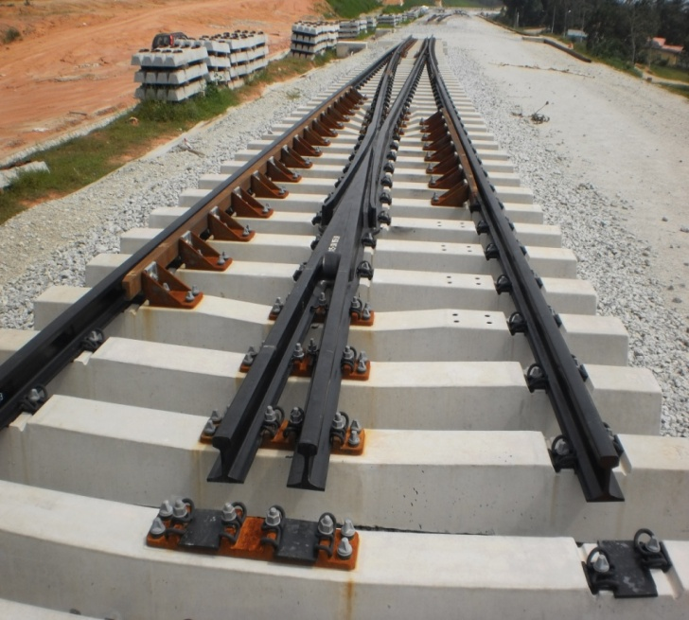
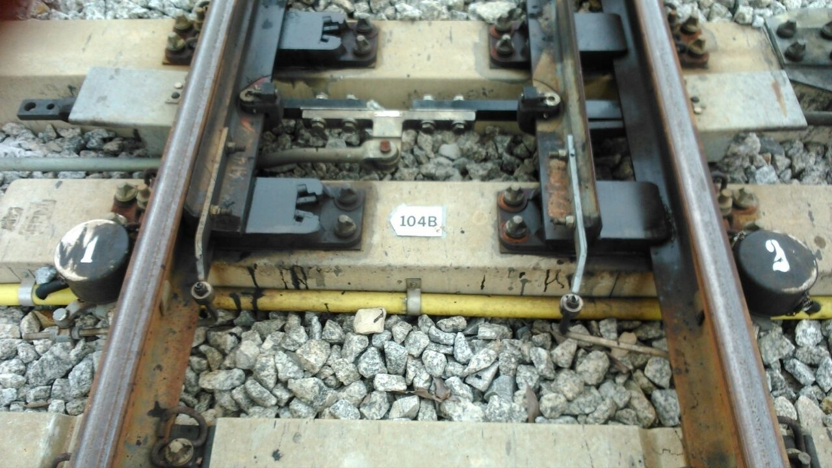
High speed Turnouts
T/O rails to be fully canted through out the length
Example : Voest Alpine / Cogifer type T/O
Weldable T/O assembly, weldable crossing
- HH rail + Nickel crome steel (12-15 mm) + Normal rail
- Flash butt weld in factory, to allow AT welding of T/O at field
Thick web switches, Roller bearing & molybdenum coated
Self lubricating bearing plates, High quality rail for whole
T/O assembly & Explosively Pre heated CMS crossings.
Swing Nose Crossing > 250 / 280 kmph
In Cab Signaling > 230 kmph
Notes:
Along with high speed track, high speed T/Os are also required, the high speed T/O are fully canted and fully weldable at SRJ, intermediate portion and at backleg of crossings. As per TSI (technical specification for Interoperatibility), un canted T/O can still be allowed for 200 kmph but beyond that, fully canted T/O assemblies are required. The swing nose crossings for avoinding gap at crossings locations are only required at speed beyond 280 kmph.

Slide 10
High Speed on Bridges
The dynamic resonant effect is more prevalent for speed more than 200 or 220 km/h and for axle distance between 13 to 20 m.
As per Euro codes EN1991-2 (2003), EN1990-A1 (2005); Dynamic analysis is mandatory for speed > 200 kmph
For old bridges, the health of existing bridges must be checked before introducing semi high speed trains.
Study shows that simply supported bridges will have more augmented dynamic response at higher speed than continuous bridges.
Notes:
As per various europian standards, dynamic analysis of bridges are required for speed 200 kmph and beyond. The literature surveyes also reveals that simply supported bridges are more susceptible to dynamic augmentation, compared to continuous bridges. Therefore a complete health monitoring of existing bridges are essentially required before permitting higher speed of 140 kmph and beyond.

Slide 11
PART C: SYSTEM REQUIREMENTS
The powering energy to run a train is proportional to Train weight & Square of speed
Thus, when train speed is raised from 130 to 160 km/h, the powering energy about 1.5 times as large is required.
For Larger supply of energy, it requires
Strengthening of substations
Increase Tension in Catenary wire
For HSR, TRC are housed with a pantograph
To detect faults in overhead wires &
Record data such as contact force, contact resistance, height, stagger & wear of the contact wire.
Notes:
For high speed tracks the electric substations needs to be strengthen up, for want of of greater energy supply. The tension in overhead contact wires also needs to be increased.
Now track recording cars are equipped with a pantograph and it can also measure contact wire parameters like its height from rail, staggering, wear n tear, and contact forces. These type of combined recording is also desirable for semi high speed tarck maintenance.

Slide 12
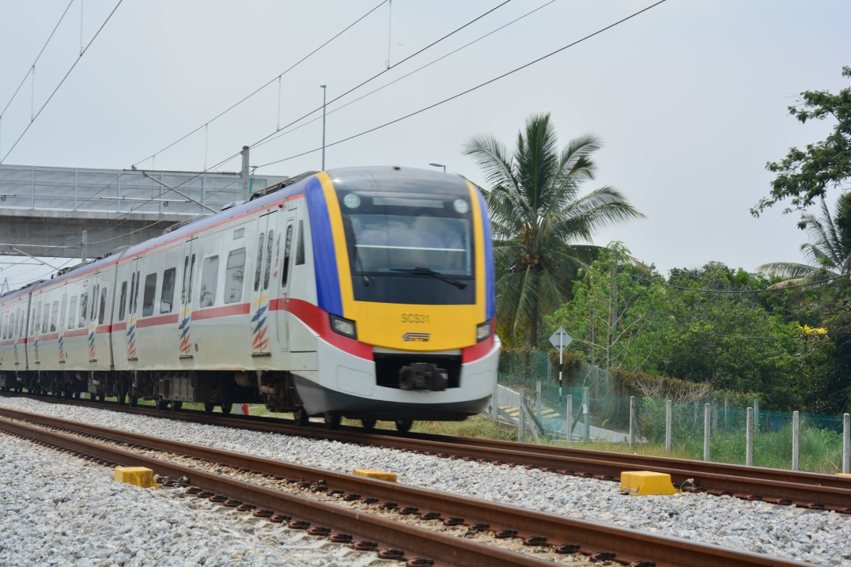
Speed | European Train Control System (ETCS) Level
upto 160 kmph | Level 1
Upto 230 kmph | Level 2
Beyond 230 kmph | Cab Signaling
ETCS Level 1
( Way side Signaling + ATP)
Way side Signaling
ETCS onboard Equipmnt
Track Side Equipmnts
Euro Belies / Transponders
Notes:
As per European Train Control System, which is widely applicable and acceptable criteria world wide, ETCS level 1 signalling system is mandatory for speed over 140 kmph.
ETCS level 1 demands Automatic train protection system wherein transponders are attached onto concrete sleepers at every signal locations or locations having permanent speed restrictions. These transponders are connected with signals and land side cabinets which are like way side mini processing units. The enroute trains are also fitted with ETCS equipments, activates the transponders when approaches it. Transponders inturn relay the signal aspect or speed restrictions as the case may be, to the train. The smart computer in the cab then checks the speed according to signal aspects and applies automatic breaks incase the speed of train is not in accordance with the signal aspects.
Thus, as per ETCS level 1, ATP system is mandatory for train speed beyond 140 kmph. In indian context, ATP may also be designed to help train operation at faster speed even during foggy weather.

Slide 13
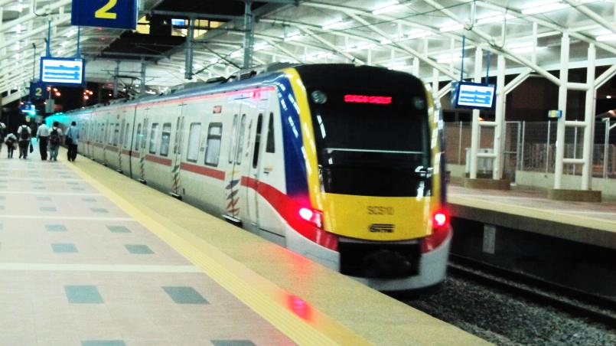
Coach Side Demand
 | 130 kmph | 160 kmph
Ride Index | 3 | 2.50 (Lateral) 2.75 (Vertical)
Equivalent Conicity | 0.5 | 0.4
Vehicle Bogie Acc.(Trans) | 4.0 m/sec² | Relatively soft wheel set guidance Primary suspension with control arm
Car Body Acc. (Trans) | 1.5 m/sec² | Air spring secondary suspension system Yaw dampers
Car Body Acc. (Trans) : Std Dev | 0.2 m/sec²
Notes:
For high speed track, high speed track friendly coaches are essentially required. There is a vast difference between coaches even for 130 kmph and 160 kmph speed potential. The semi high speed coaches are designed for stringent Ride index and equivalent conicity value than conventional coaches. The permitted lateral and longitudinal acceleration of coaches at bogie and coach level, are also reduced for high speed coaches. The bogie acceleration is reduced by designing relatively soft wheel set guidance and providing control arm in primary suspension system. The coach level acceleration is reduced by providing air suspension system at secondary suspension level along with yaw dampers.

Slide 14
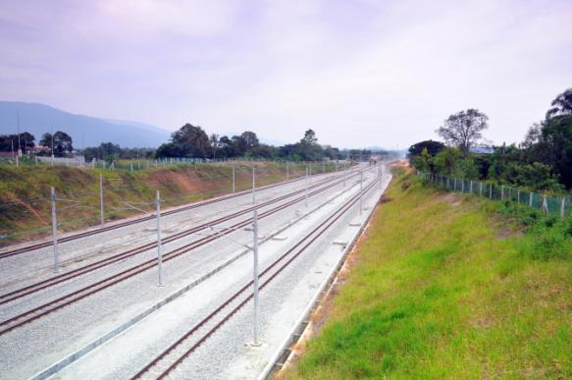
PART D
SGEDT Project/ Malaysia
160 kmph on Meter Gauge;
Equivalent to
230-300 kmph Standard Gauge
 | Standard Gauge / Broad Gauge (as per EN 13848-5) | Meter Gauge (as per Statement Of Needs, SGEDT Project)
Speed | 230-300 kmph | 160 kmph
Gauge (tight) | -3 mm | -2 mm
Alignment | 4-7 mm | 6 mm
Vertical profile | 6-10 mm | 10 mm
Twist | 3 mm/m | 2 mm/m
Notes:
The SGEDT project costing us$ 1 billion, was designed, constructed and successfully commissioned by Ircon at Malaysia. Its a semi high speed CWR track with speed potential of 160 kmph on meter gauge. As can be seen from the table, the construction tolerances for 160 kmph track on meter gauge are equivalent to 230 kmph track tolerances on standard/ broad gauge. This shows allowing higher speed on meter gauge is much more difficult than allowing the same speed on standard or broad gauge track.

Slide 15
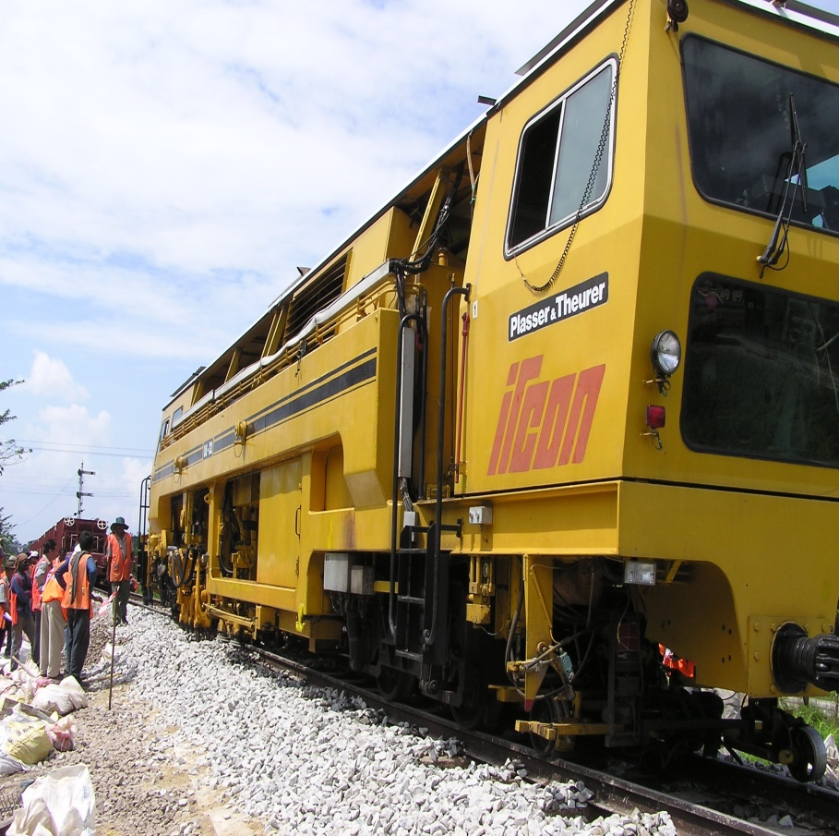
Maintenance Tolerances for Semi High Speed Track
(EN 13848-5:2008, Annex. B)
 | Alignment |  | Vertical |  | Twist ( 3 m base)
 | Individual peak | St. dev (200m); 0-25 m | Individual peak | St. dev (200m); 0-25 m
130-160 kmph | 6 – 9 mm | 1.0 - 1.3 mm | 8 – 15 mm | 1.4 - 2.4 mm | 4 mm / m
160-230 kmph | 5 – 8 mm | 0.8 - 1.1 mm | 7 – 12 mm | 1.2 - 1.9 mm
Notes:
The SGEDT track was maintained by Ircon within following tight track tolerances. These track tolerances are as per europian standard track tolerances for maintenance and for speed upto 160 kmph.
Here we can notice that apart from individual defect’s peak, standard deviations of all track defects were also recorded and further rectified accordingly.

Slide 16
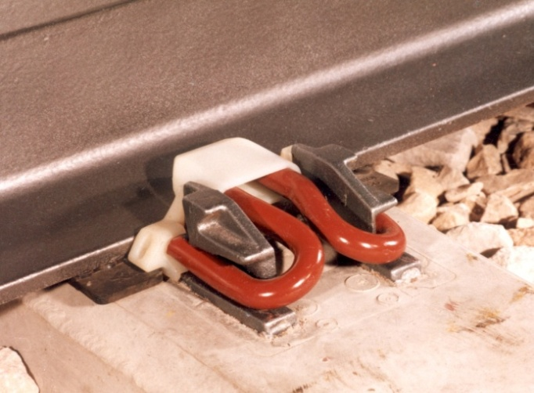
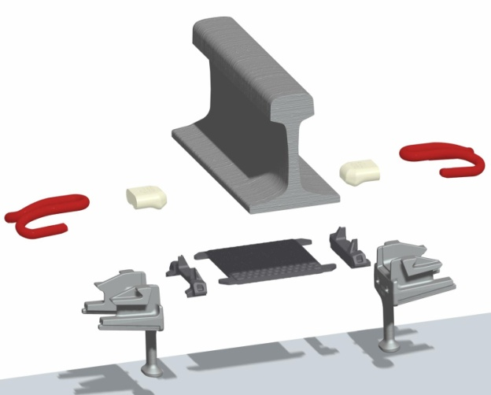
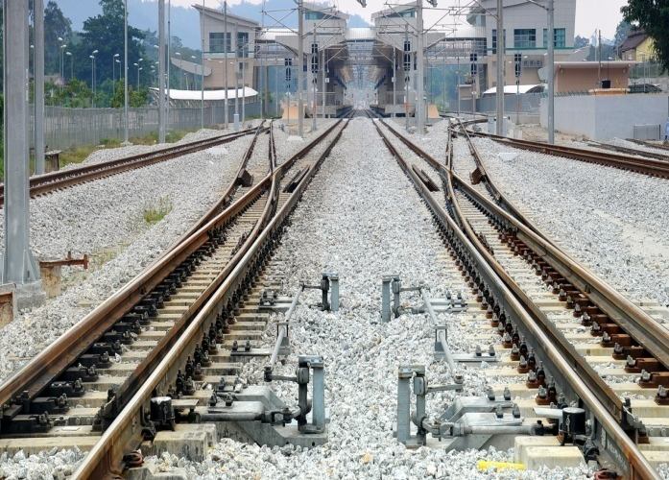
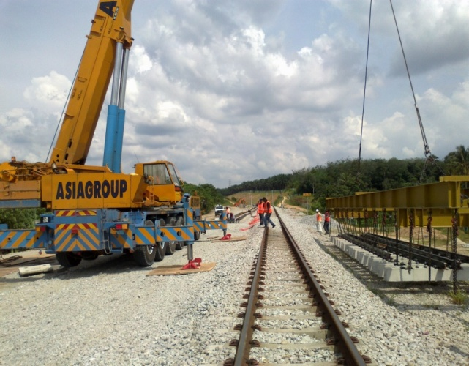
SGEDT /Malaysia: Semi High Speed Track
High Standard Initial Track Laying
GPS controlled survey, CWR track, less stiff 9 mm R/pad (stiffness <100 kn/mm) and elastic resilient fittings, Heavy sleepers
Fully weldable, fully Canted T/O assembly
Notes:
These are some of the highlights from track side of SGEDT project. Elastic resilient fasteners were used, which still retain toe load of around 7 kn, even at defected track geometry under wheel load. 9 mm Thick soft rubber pads were used for isolating vibrating frequency at sleeper level. Heavier concrete sleepers were used owing to CWR track structure.
Fully canted and fully weldable, with self lubricating sliding plates type high speed T/O were provided in SGEDT project. For high speed T/O, the permitted speed in 1st loop is 65 kmph and 35 kmph for the second loop.

Slide 17
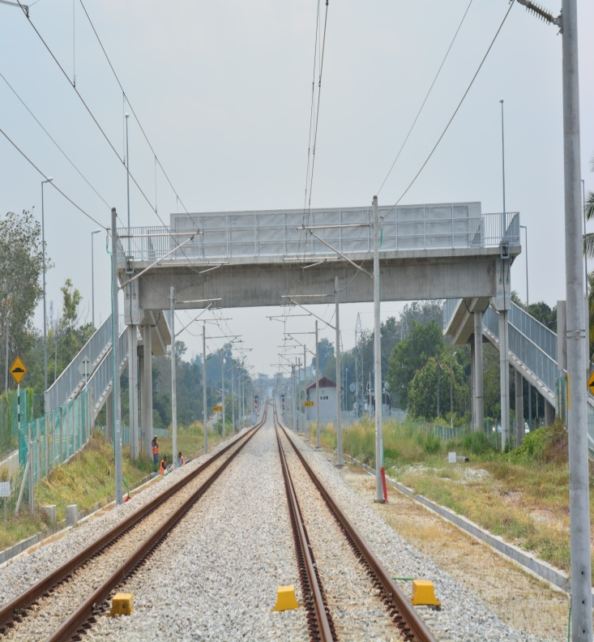
SGEDT /Malaysia: Semi High Speed Track
No Level Crossings
Pedestrian Bridge /
Motor Cycle cum
Pedestrian Bridge
(9 Nos. in 100 km)
Throughout Track Side Drains
Advance Mechanised Track Maintenance
(Spatial curve measuring system, ALC)
Track tamping with Absolute Co-ordinate System
Notes:
All the level crossings were eliminated by providing ROBs, pedestrian bridges and motorcycle cum pedestrian bridges. In a total stretch of 100 km, there are 13 ROBs and 9 MPB in SGEDT project. Also the track was fully fenced and all along the track, side drains were provided.
For maintenance, the track tamping was done based on absolute co-ordinate system, instead of smoothening or design mode. With this practice, the original track alignment as well as catenary alignment were always retained.

Slide 18
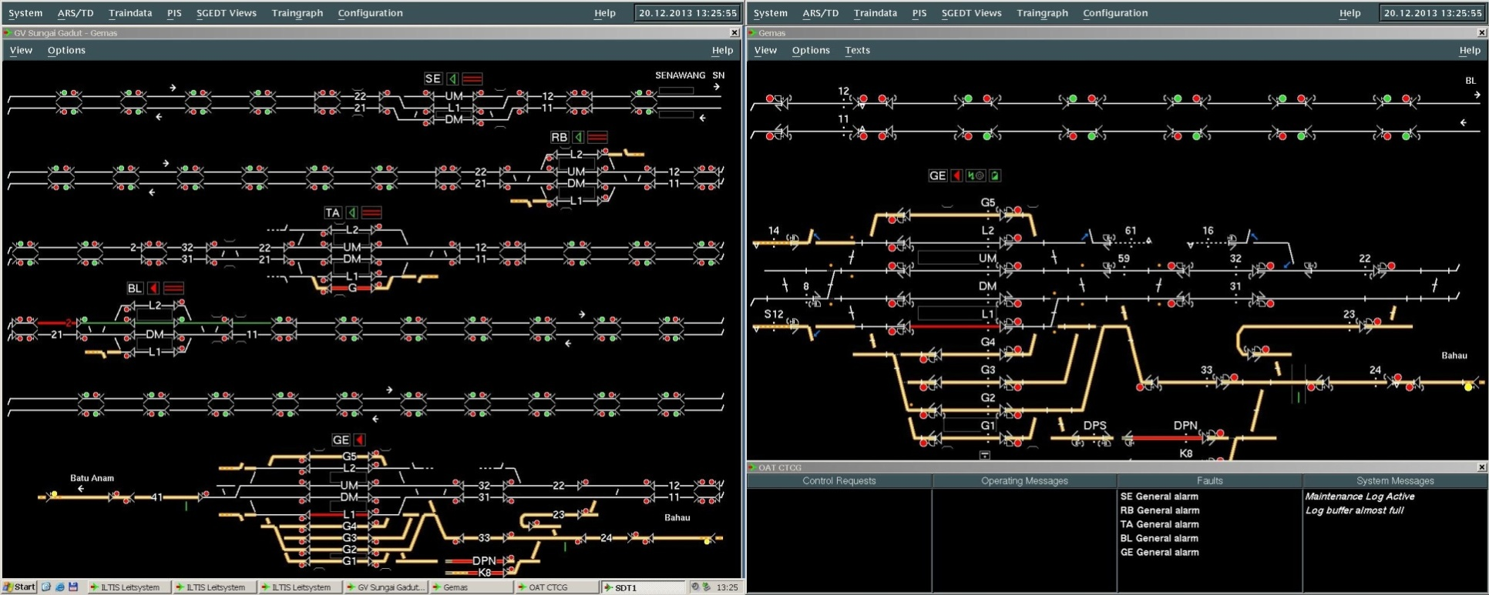
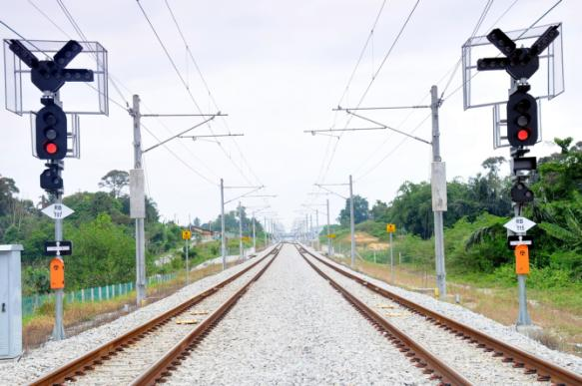
SGEDT /Malaysia: System

Slide 19
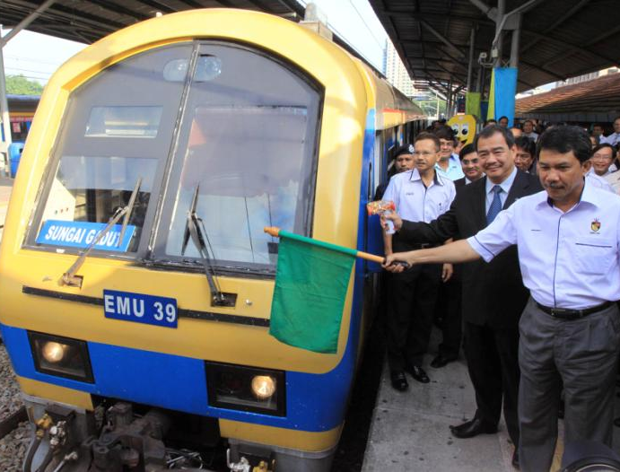
Thank YOU

